Slide 1

ANDRA PRADESH HEALTH DATA
BY SUBHAHARINI

Slide 2
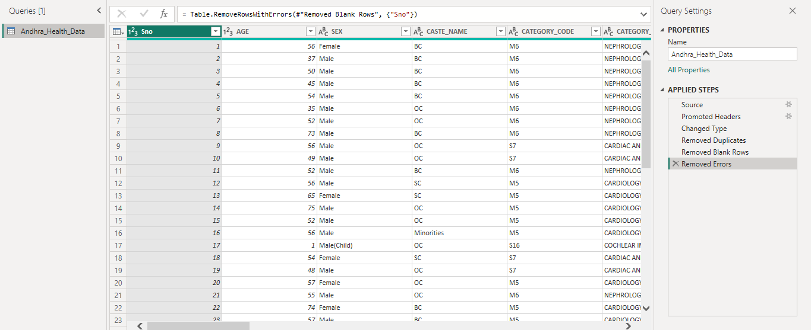
DATA TRANSFORMATION

Slide 3
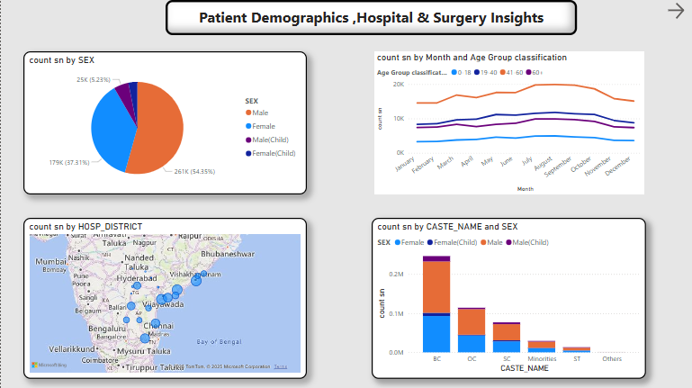

Slide 4
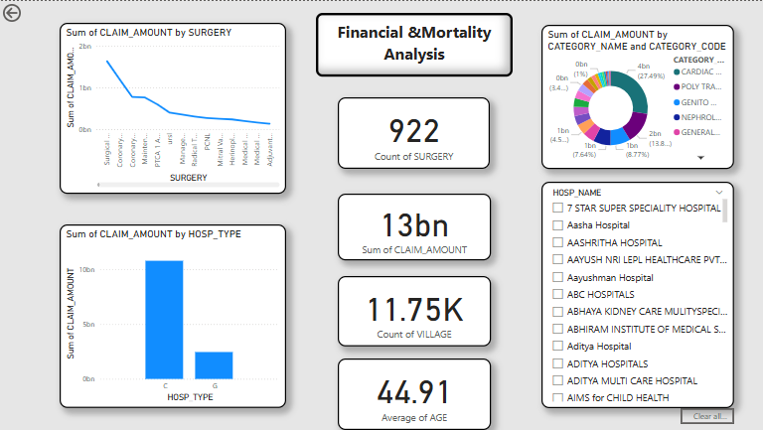

Slide 5
INSIGHTS & SUMMARY
Female patients (37.31%) and Male adults (54.35%) dominate the dataset.
Men have the highest claim counts, suggesting a higher need for medical interventions.
Female children & Male children have lower counts (possibly due to fewer surgeries or claims).
Implement targeted healthcare programs for men, focusing on preventive checkups (especially for cardiovascular issues).
Implement targeted healthcare programs for men, focusing on preventive checkups (especially for cardiovascular issues).
Introduce preventive health screenings for people aged 40+ to reduce high-cost claims in later stages.

